Slide 1
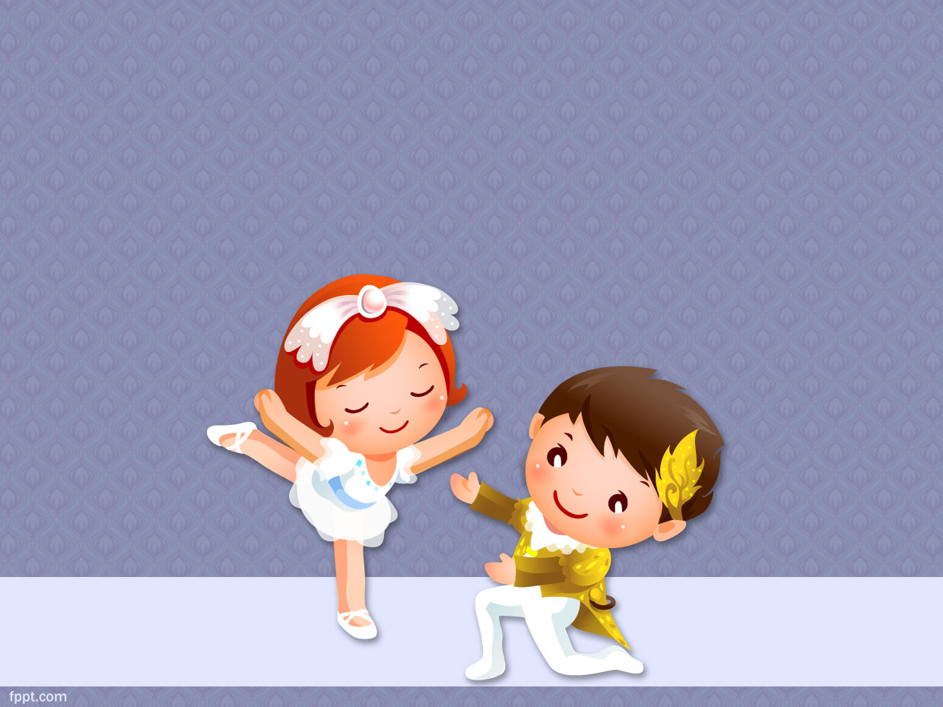
Unit 9: Childhood Mental Health Problems

Slide 2
Introduction
Mental health in childhood means reaching developmental and emotional milestones, and learning healthy social skills and how to cope when there are problems.
Mentally healthy children have a positive quality of life and can function well at home, in school, and in their communities.
Mental disorders among children are described as serious changes in the way children typically learn, behave, or handle their emotions, which cause distress and problems getting through the day.

Slide 3
According to WHO, worldwide 10-20% of children and adolescents experience mental disorders. Half of all mental illnesses begin by the age of 14 and three-quarters by mid-20s.
Neuropsychiatric conditions are the leading cause of disability in young people in all regions.
Children with mental disorders face major challenges with stigma, isolation and discrimination, as well as lack of access to health care and education facilities, in violation of their fundamental human rights.

Slide 4
Autism/ Autism Spectrum Disorder (ASD)

Slide 5
Introduction
Complex neurobiological and developmental disabilities that typically appears during a child’s first three years of life.
Autism affects the normal development of the brain in social interaction and communication skills.
It ranges in severity from mild to moderate to severe.

Slide 6
Definition
Autistic disorder is a childhood disorder characterized by a withdrawal of the child into the self and into a fantasy world of his or her own creation. The child has markedly abnormal or impaired development in social interaction and communication and a markedly restricted repertoire of activity and interests (APA, 2000). Activities and interests are restricted and may be considered somewhat bizarre.

Slide 7
Definition
A pervasive developmental disorder defined by the presence of abnormal and/or impaired development that is manifest before the age of 3 years, and by the characteristic type of abnormal functioning in all three areas of social interaction, communication, and restricted, repetitive behaviour (ICD 10).
The disorder occurs in boys three to four times more often than in girls.
One in 160 children has an autism spectrum disorder.
ASDs begin in childhood and tend to persist into adolescence and adulthood.

Slide 8
Predisposing factors
Biological Factors
Neurological Factors. Autism is caused by abnormalities in brain structures or functions (National Institute of Mental Health [NIMH], 2004). These include ventricular enlargement, left temporal lobe abnormalities, and increased glucose metabolism.
Alterations in serotonin synthesis have been observed in people with autism.
Popper, Gammon, West, and Bailey (2003) identify early developmental problems such as postnatal neurological infections, congenital rubella, phenylketonuria, and fragile X syndrome as possible implications in the predisposition to autistic disorder.

Slide 9
Genetics.
Genetic factors play a significant role in the etiology of autism (Andreasen & Black, 2006).
Parents who have one child with autism are at increased risk for having more than one child with autism.
Both monozygotic and dizygotic twins also have provided evidence of a genetic involvement.

Slide 10
Environmental factors
Advanced parental age at time of conception
Prenatal exposure to air pollution or certain pesticides or medicines such as valporic acid.
Maternal obesity, diabetes, or immune system disorders
Extreme prematurity or very low birth weight
Any birth difficulty leading to periods of oxygen deprivation to the baby’s brain

Slide 11
Symptoms
Symptoms associated with autism spectrum disorders include significant deficits in social relatedness, including communication, nonverbal behavior, and age-appropriate interaction.
There are deficits in developing and maintaining relationships.
Other behaviors include stereotypical repetitive speech, use of objects, overadherence to routines or rituals, fixations with particular objects, hyper- or hypo-reactivity to sensory input, and extreme resistance to change.
The symptoms will first occur in childhood and cause impairments in everyday functioning.

Slide 12
Social issues
Does not respond to name by 12 months of age
Avoids eye-contact
Prefers to play alone
Does not share interests with others
Only interacts to achieve a desired goal
Has flat or inappropriate facial expressions
Does not understand personal space boundaries
Avoids or resists physical contact
Is not comforted by others during distress
Has trouble understanding other people’s feelings or talking about own feelings

Slide 13
Communication and language
Delayed speech and language skills.
About 40% of children with an ASD do not talk at all. About 25%–30% of children with ASD have some words at 12 to 18 months of age and then lose them.¹ Others might speak, but not until later in childhood.
Repeats words or phrases over and over (echolalia)
Reverses pronouns (e.g., says “you” instead of “I”)
Gives unrelated answers to questions
Does not point or respond to pointing
Uses few or no gestures (e.g., does not wave goodbye)
Talks in a flat, robot-like, or sing-song voice
Does not pretend in play (e.g., does not pretend to “feed” a doll)
Does not understand jokes, sarcasm, or teasing

Slide 14
Activities
Marked restricted, repertoire of activities and interests.
Stereotyped body movements e.g.hand flicking or twisting, spinning, head banging, etc.
Persistent preoccupation with parts of objects (e.g.spinning wheels of toy cars)or attachment to unusual objects.
Marked distress over changes in trivial aspects of environment.
Markedly restricted range of interests and a preoccupation with one narrow interest.

Slide 15
Other features
More than half of autistic children have moderate to profound mental retardation, whereas about 25%have mild mental retardation
Hyperactivity (very active)
Impulsivity (acting without thinking)
Short attention span
Aggression
Causing self injury
Temper tantrums
Unusual eating and sleeping habits
Unusual mood or emotional reactions
Lack of fear or more fear than expected
Unusual reactions to the way things sound, smell, taste, look, or feel

Slide 16
Treatment
Early Intervention for Autism
Early diagnosis of and interventions for autism are more likely to have major long-term positive effects on symptoms and later skills. Early interventions occur at or before preschool age, as early as 2 or 3 years of age. The sooner a child gets help, the greater the chance for learning and progress.
Early intervention programs often include:Family training
  Speech therapy
  Hearing impairment services
  Physical therapy
  Nutrition services

Slide 17
Early intervention programs help children gain the basic skills that they usually learn in the first 2 years of life, such as:
  Physical skills
  Thinking skills
  Communication skills
  Social skills
  Emotional skills
Behavioral Management Therapy
Behavior management therapy tries to reinforce wanted behaviors and reduce unwanted behaviors. It also suggests what caregivers can do before, during, after, and between episodes of problem behaviors.

Slide 18
Cognitive Behavior Therapy for Autism
Cognitive behavior therapy focuses on the connection between thoughts, feelings, and behaviors.
The person with autism learns to identify and change thoughts that lead to problem feelings or behaviors in particular situations.
Social Skills Training for Autism
Social skills training teaches children the skills they need to interact with others. It includes repeating and reinforcing certain desired behaviors.
It helps children to improve several social skills:
  Conversation
  Handling teasing
  Being a good sport
  Showing good host behavior during play dates

Slide 19
Joint Attention Therapy
Many people with autism have difficulty with joint attention, which is the ability to share focus on an object or area with another person. Examples of joint attention skills include following someone else's gaze or pointed finger to look at something.
Joint attention is important to communication and language learning. Joint attention therapy focuses on improving specific skills related to shared attention,¹ such as:
  Pointing
  Showing
  Coordinating looks between a person and an object

Slide 20
Parent-Mediated Therapy in Autism
In parent-mediated therapy, parents learn therapy techniques from professionals and provide specific therapies to their own child. This approach gives children with autism spectrum disorder (ASD) consistent reinforcement and training throughout the day. Parents can also conduct some therapies with children who are at risk of autism but are too young to be diagnosed.
Several types of therapies can be parent-mediated activities, including:
  Joint attention therapy
  Social communication therapy
  Behavioral therapy
Studies suggest that parent-mediated therapies might be able to improve the child's communication skills and interactions with others.

Slide 21
Occupational Therapy
Occupational therapy can help children with autism perform better in school and home environments.
Occupational therapy helps people with autism spectrum disorder (ASD) do everyday tasks by finding ways to work within and make the most of their needs, abilities, and interests.

Slide 22
Medication Treatment for Autism
Currently, there is no medication that can cure autism spectrum disorder (ASD) or all of its symptoms. But some medications can help treat certain symptoms associated with ASD, especially certain behaviors.
The medications used most frequently include antipsychotics (e.g., Risperidone) and Selective Serotonin Reuptake Inhibitors (SSRI) to treat mood and repetitive behaviour problems, and stimulants and other medications used to treat ADHD-related symptoms (Lindgren & Doobay, 2011).

Slide 23
Nursing Diagnosis
Risk for self-mutilation related to neurological alterations.
Impaired social interaction related to inability to trust; neurological alterations.
Impaired verbal communication related to withdrawal into the self; inadequate sensory stimulation; neurological alterations.
Disturbed personal identity related to inadequate sensory stimulation; neurological alterations.

Slide 24
Interventions
Risk for self-mutilation
1. Work with the child on a one-to-one basis.
2. Try to determine if the self-mutilative behavior occurs in response to increasing anxiety, and if so, to what the anxiety may be attributed.
3. Try to intervene with diversion or replacement activities and offer self to the child as anxiety level starts to rise.
4. Protect the child when self-mutilative behaviors occur. Devices such as a helmet, padded hand mitts, or arm covers may provide protection when the risk for self-harm exists.

Slide 25
Impaired social interaction
1. Assign a limited number of caregivers to the child. Ensure that warmth, acceptance, and availability are conveyed.
2. Provide child with familiar objects, such as familiar toys or a blanket. Support child’s attempts to interact with others.
3. Give positive reinforcement for eye contact with something acceptable to the child (e.g., food, familiar object).Gradually replace with social reinforcement (e.g., touch, smiling, hugging).

Slide 26
Impaired verbal communication
1. Maintain consistency in assignment of caregivers.
2. Anticipate and fulfill the child’s needs until communication can be established.
3. Seek clarification and validation.
4. Give positive reinforcement when eye contact is used to convey nonverbal expressions.

Slide 27
Disturbed personal identity
1. Assist child to recognize separateness during self-care activities, such as dressing and feeding.
2. Assist the child in learning to name own body parts. This can be facilitated by the use of mirrors, drawings, and pictures of the child. Encourage appropriate touching of, and being touched by, others.

Slide 28
MENTAL RETARDATION/ INTELLECTUAL DISABILITY

Slide 29
Introduction
According to The American Association on Mental Retardation, Mental retardation (MR) refers to substantial limitations in present functioning. It starts before age 18 and is characterized by significantly sub-average intellectual functioning, existing concurrently with related limitations in two or more of the following applicable adaptive skill areas:
  communication
  self-care
  home living
  social skills
  community use
  self-direction
  health and safety
  functional academics
  leisure
  Work

Slide 30
Mental retardation is a condition of arrested or incomplete development of the mind, which is especially characterized by impairment of skills manifested during the developmental period, which contribute to the overall level of intelligence, i.e. cognitive, language, motor, and social abilities. Retardation can occur with or without any other mental or physical disorder (ICD 10).

Slide 31
Types of MR according to ICD 10
F70 Mild MR: IQ : 50 to 69
Mildly retarded people acquire language with some delay but most achieve the ability to use speech for everyday purposes, to hold conversations, and to engage in the clinical interview.
Most of them also achieve full independence in self-care (eating, washing, dressing, bowel and bladder control) and in practical and domestic skills, even if the rate of development is considerably slower than normal.
The main difficulties are usually seen in academic school work, and many have particular problems in reading and writing.
However, mildly retarded people can be greatly helped by education designed to develop their skills and compensate for their handicaps.

Slide 32
F71 Moderate MR: IQ : 35 to 49.
Individuals in this category are slow in developing comprehension and use of language, and their eventual achievement in this area is limited.
Achievement of self-care and motor skills is also retarded, and some need supervision throughout life.
Progress in school work is limited, but a proportion of these individuals learn the basic skills needed for reading, writing, and counting.
Educational programmes can provide opportunities for them to develop their limited potential and to acquire some basic skills.
As adults, moderately retarded people are usually able to do simple practical work, if the tasks are carefully structured and skilled supervision is provided.

Slide 33
F72 Severe mental retardation: IQ : 20 to 34.
This category is broadly similar to that of moderate mental retardation in terms of the clinical picture, the presence of an organic etiology, and the associated conditions.
The lower levels of achievement mentioned under F71 are also the most common in this group.
Most people in this category suffer from a marked degree of motor impairment or other associated deficits, indicating the presence of clinically significant damage to or maldevelopment of the central nervous system.

Slide 34
F73 Profound mental retardation: IQ : under 20.
The IQ in this category is estimated to be under 20, which means in practice that affected individuals are severely limited in their ability to understand or comply with requests or instructions.
Most such individuals are immobile or severely restricted in mobility, incontinent, and capable at most of only very rudimentary forms of nonverbal communication.
They possess little or no ability to care for their own basic needs, and require constant help and supervision.

Slide 35
F78 Other mental retardation
This category should be used only when assessment of the degree of intellectual retardation by means of the usual procedures is rendered particularly difficult or impossible by associated sensory or physical impairments, as in blind, deaf-mute, and severely behaviourally disturbed or physically disabled people.
F79 Unspecified mental retardation
There is evidence of mental retardation, but insufficient information is available to assign the patient to one of the above categories.

Slide 36
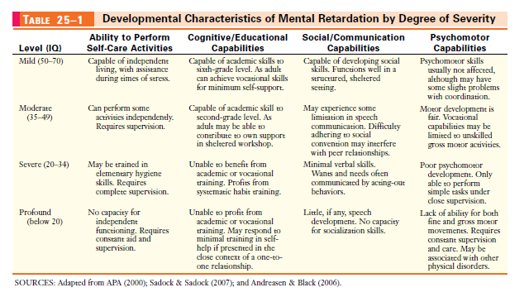

Slide 37
Causes/Risk Factors
  Various genetic disorders (e.g. Down’s Syndrome, phenylketonuria)
  Certain maternal infections during pregnancy (e.g. rubella)
  Mother who abuses substances such as alcohol during pregnancy
  Certain psychosocial conditions (e.g. problems with caregiving, low socioeconomic status, low parental education)
  Maternal exposure to various drugs (e.g. thalidomide, valproic acid)
  Maternal exposure to environmental chemicals (mercury, lead, cadmium, tobacco smoke)

Slide 38
Management
a) Specific treatment
  • Early identification & prevention‐ PKU
  • Treatable conditions‐IDA, hypothyroidism
  • Symptomatic‐anticonvulsants, Medical/surgical
  • intervention for associated anomalies eg: CHD
b) Associated impairments
  • Behavior management techniques
  • Pshyco-pharmacological agents
  • Stimulant agents‐ADHD
  • Neuroleptics‐self injurious behavior
  • SSRIs ‐ anxiety & depression

Slide 39
c) Supportive treatment
AIM : “Normalizing and mainstreaming‐integrate the children in
society and discourage institutionalization. “
– Early stimulation
– Special schooling
– Vocational training
– Primary health care –nutrition, immunization
– Periodic evaluation
– Co‐ordinate interdisciplinary services
  • Psychology
  • Speech & language
  • Physiotherapy
  • Audiology
  • Social work

Slide 40
d) Parental counseling
•Individualized approach based on severity, etiology, prognosis
•Breaking the news‐phased manner
  ✓Not to be done abruptly/should not use offending terms
  like madness.
  ✓Positive aspects of the disease should be discussed first,
  followed by the problems but do not with hold the truth.
•Ensure full participation of family members with special support
to the mother.
•Protect against possible physical or sexual abuse.
•Information regarding parent groups, support organizations and

Slide 41
Prevention
Primary (eliminating the cause)
For all
  •Iodine and iron supplementation
  •Prevent exposure against environmental toxin
  •Improve socioeconomic status
  •Avoid consanguinity
Pregnant mothers
  •Safe motherhood years 20‐35 yrs
  •Peri-conceptional folate
  •Good antenatal care/perinatal care
Children
  •Routine immunization

Slide 42
Secondary (Preventing the expression of a disorder)
  • Early diagnosis and treatment of curable illnesses -hypothyroidism, galactosemia, PKU
  • Prenatal diagnosis ‐ chorionic villus sampling,
  Amniocentesis, Cord blood sampling
  • Genetic counseling ‐ exact etiology/empiric risk figures
Tertiary prevention (Minimizing the consequences)
  • Early rehabilitative interventions and support
  • Use of professional services

Slide 43
Nursing Diagnosis
Risk for injury related to altered physical mobility or aggressive behavior.
Self-care deficit related to altered physical mobility or lack of maturity.
Impaired verbal communication related to developmental alteration.
Impaired social interaction related to speech deficiencies or difficulty conforming to conventional social behavior.

Slide 44
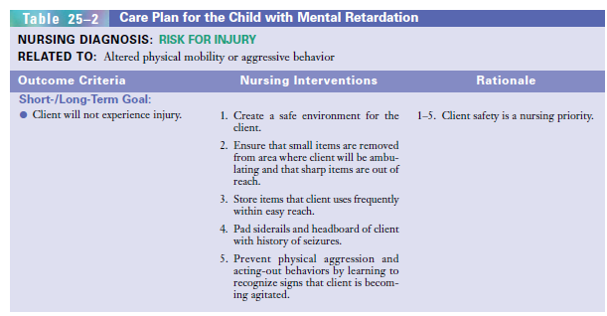

Slide 45
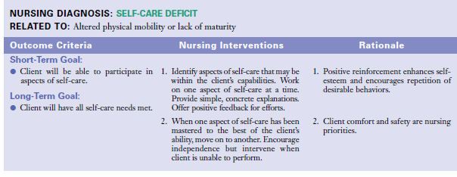

Slide 46
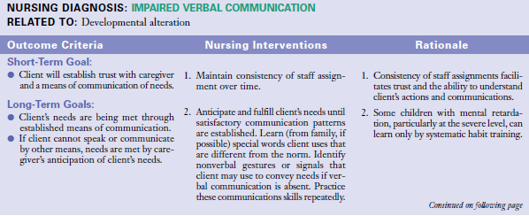

Slide 47
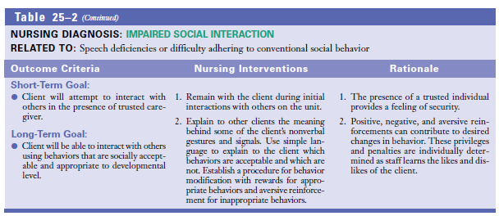

Slide 48
Attention Deficit Hyperactivity Disorder (ADHD)/ Hyperkinetic Disorder

Slide 49
Attention deficit hyperactivity disorder (ADHD) is a persistent pattern of inappropriate degree of inattention, impulsiveness, and hyperactivity.
Some children can have attention deficit disorder without hyperactivity (ADD).
In order to diagnose a child with ADHD symptoms must be present in at least two settings (e.g., at home and school) and occur before age twelve.

Slide 50
Etiology
Biological influences
Genetic factors
There is greater concordance in monozygotic than in dizygotic twins
Siblings of hyperactive children have about twice the risk of having the disorder as does the general population
Biological parents of children with the disorder have a higher incidence of ADHD than do adoptive parents
Biochemical theory
A deficit of dopamine and norepinephrine has been attributed in the overactivity seen in ADHD.

Slide 51
Pre, peri and postnatal factors
Prenatal toxic exposure, prenatal mechanical insult to the fetal nervous system
Prematurity, fetal distress, precipitated or prolonged labor, perinatal asphyxia and low Apgar scores
Postnatal infections,CNS abnormalities resulting from trauma, etc

Slide 52
Environmental influences
  Environmental lead
  Food additives, coloring preservatives and sugar have also been suggested as possible causes of hyperactive behavior but there is no definite evidence
Psychosocial factors
  • Prolonged emotional deprivation
  • Stressful psychic events
  • Disruption of family equilibrium

Slide 53
Symptoms
hyperactivity,
difficulty taking turns
Difficulty in maintaining social relationships,
high levels of impulsivity,
poor social boundaries,
intrusive behaviors,
frequently interrupting others.
Those with inattentive type of ADHD may exhibit
High degrees of distractibility and disorganization;
Unable to complete challenging or tedious tasks,
become easily bored, lose things frequently,
require frequent prompts to complete tasks.

Slide 54
Treatment
Pharmacotherapy
CNS stimulants: Dextroamphetamine, methylphenidate, pemoline
Tricyclic antidepressants
Antipsychotics
Serotonin specific re-uptake inhibitors
Clonidine
Psychological therapies
Behavior modification techniques
Cognitive behavior therapy
Social skills training

Slide 55
Nursing Diagnosis
Risk for injury related to impulsive and accident-prone behavior and the inability to perceive self-harm.
Impaired social interaction related to intrusive and immature behavior.
Low self-esteem related to dysfunctional family system and negative feedback.
Noncompliance with task expectations related to low frustration tolerance and short attention span.

Slide 56
Nursing Intervention
Develop a trusting relationship with the child.
Convey acceptance of the child separate from the unacceptable behavior.
Ensure that patient has a safe environment.
Remove objects from immediate area in which patient could injure self due to random hyperactive movements. Identify deliberate behaviors that put the child at risk for injury.

Slide 57
Institute consequences for repetition of this behavior. Provide supervision for potentially dangerous situations.
Since there is non-compliance with task expectations, provide an environment that is as free of distractions as possible.
Ensure the child's attention by calling his name and establishing eye contact, before giving instructions.
Ask the patient to repeat instructions before beginning a task.
Establish goals that allow patient to complete a part of the task, rewarding each step completion with a break for physical activity.

Slide 58
Provide assistance on a one-to-one basis, beginning with simple concrete instructions.
Gradually decrease the amount of assistance given to task performance, while assuring the patient that assistance is still available if deemed necessary.
Offer recognition of successful attempts and positive reinforcementforattempts made. Give immediate positive feedback for acceptable behavior.
Provide quiet environment, self-contained classrooms, and small group activities. Avoid over stimulating places such as cinema halls, bus stops and other crowded places.

Slide 59
Assess parenting skill level, considering intellectual, emotional and physical strengths and limitations. Be sensitive to their needs as there is often exhaustion of parental resources due to prolonged coping with a disruptive child.
Provide information and materials related to the child's disorder and effective parenting techniques. Give instructional materials in written and verbal form with step-by-step explanations.

Slide 60
Explain and demonstrate positive parenting techniques to parents or caregivers, such as time-in for good behavior, or being vigilant in identifying the child's behavior and responding positively to that behavior.
Educate child and family on the use of psychostimulants and anticipated behavioral response.
Coordinate overall treatment plan with schools, collateral personnel, the child and the family.

Slide 61
CONDUCT DISORDER

Slide 62
Introduction
Conduct disorders are characterized by a persistent and significant pattern of conduct in which the basic rights of others are violated or rules of society are not followed.
Conduct disorders are characterized by a repetitive and persistent pattern of dissocial, aggressive, or defiant conduct.
The diagnosis is only made when the conduct is far in excess of the routine mischief of children and adolescents.
The onset occurs much before 18 years of age, usually even before puberty.
The disorder is much more (about 5 to10 times) common in boys.

Slide 63
Etiology
Genetic factors:
Studies with monozygotic and dizygotic twins as well as with non-twin siblings have revealed a significantly higher number of conduct disorders among those whose family members are affected with the disorder (Baum,1989).
Alcoholism and personality disorder in the father is reported to be strongly associated with conduct disorders.
Biochemical factors
Various studies have reported a possible correlation between elevated plasma levels of testosterone and aggressive behaviors.

Slide 64
Organic factors
Children with brain damage and epilepsy are more prone to conduct disorders.
Psychosocial factors
Parental rejection.
Inconsistent management with harsh discipline.
Frequent shifting of parental figures.
Large family size.
Absent father.
Parents with antisocial personality disorder or alcohol dependence.
Parental permissiveness.
Marital conflict and divorce in parents.
Associations with delinquent subgroups.
Inadequate/inappropriate communication patterns in the family.

Slide 65
Symptoms
Excessive levels of fighting or bullying;
Cruelty to animals or other people;
Severe destructiveness to property;
Fire-setting;
Stealing;
Repeated lying;
Truancy from school and running away from home;
Unusually frequent and severe temper tantrums;
Defiant provocative behaviour; and
Persistent severe disobedience.

Slide 66
Treatment
Cognitive behavioral therapy is used to help an individual manage impulsive behaviors and deal with stress with positive coping strategies.
Family therapy can help family members communicate more effectively and also help parents learn strategies for de-escalating conflict with their child. Family therapy can also help reduce risk factors that lead to antisocial behaviors in the child.
Group therapy with the child or teen’s peers is also sometimes used to help them develop interpersonal skills and behaviors that foster empathy.

Slide 67
School support is another important part of treatment for conduct disorder. For children and teens in school, a team of people will be assembled to help the child with conduct disorder. This team typically involves school counselors, school psychologists, social workers, administrators, and others.
Drug treatment may be indicated in the presence of epilepsy (anticonvulsants), hyperactivity (stimulant medication), impulse control disorder and episodic aggressive behavior (lithium, carbamazepine) and psychotic symptoms (antipsychotics).

Slide 68
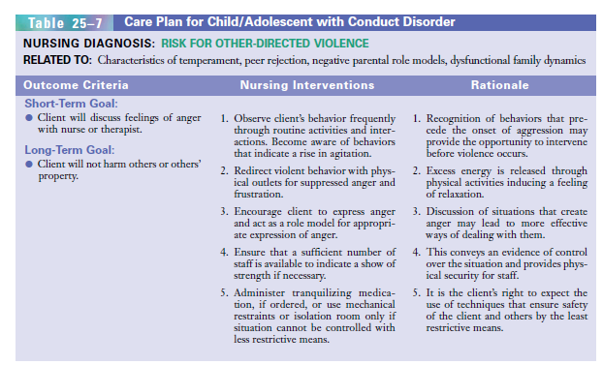

Slide 69
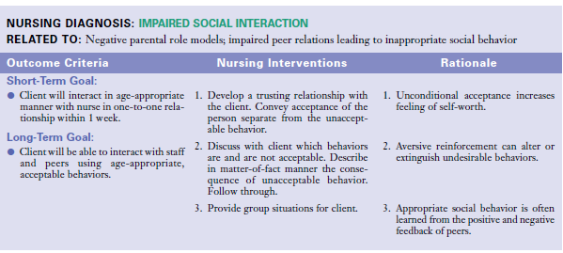

Slide 70
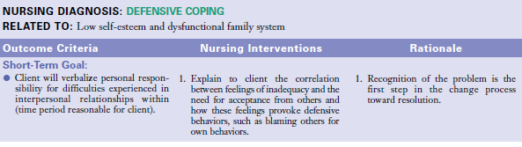
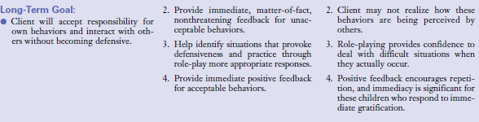

Slide 71
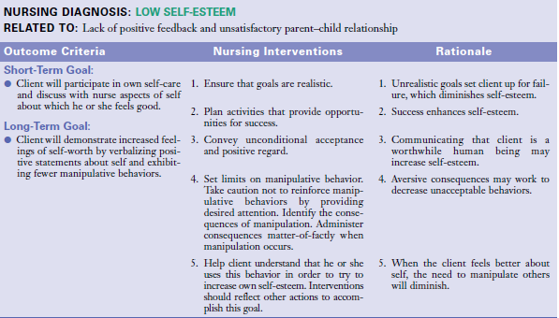

Slide 72
Enuresis

Slide 73
Enuresis
Enuresis is the repeated voiding of urine during the day or at night into clothing or bed by a child at least 5 years of age either chronologically or developmentally and which is not a consequence of a lack of bladder control due to any neurological disorder, epileptic attacks or any structural abnormality of urinary tract.
Most often enuresis is involuntary; when intentional, it is associated with a disruptive behavior disorder.
Seventy-five percent of children with enuresis have a first-degree relative who had the disorder. Most children with enuresis do not have a coexisting mental disorder.
In most cases, enuresis is primary (the child has never attained bladder control). Sometimes it may be secondary (enuresis starting after the child achieved continence for a certain period of time).

Slide 74
Both encopresis and enuresis are more common in boys than in girls; 1% of all 5 year olds have encopresis, and 5% of all 5 year olds have enuresis.
Most children with enuresis are continent by adolescence; only 1% of all cases persist into adulthood.
Impairment associated with elimination disorders depends on the limitations on the child’s social activities, effects on self-esteem, degree of social ostracism by peers, and anger, punishment, and rejection on the part of parents or caregivers (APA, 2000).

Slide 75
Factors Associated with Enuresis
Faulty training: If toilet training is started too early, and especially if coercive, produces confusion and resentment rather than compliance. Also, if it is begun too late, loss of bladder control can result.
Emotional disturbances: Emotional problems or conflicts can manifest in the form of disturbed bladder control. These conflicts may be due to such factors like dominating parents, harsh punishments and other problems in the family, causing the child to feel neglected and isolated. As the children grow older, they become sensitive about their habit of bedwetting. They develop feelings of inferiority and a sense of being different from other children, which aggravates the problem even further.
Physical diseases and anatomic defects (e.g. congenital anomalies of the genitourinary tract, diseases involving the central nervous system) are relatively rare causes for enuresis.

Slide 76
Management
Exclude any physical basis for enuresis by history, examination and if necessary, investigation of the renal tract.
Explain the parents and child about the maturational basis of the problem and the likelihood of spontaneous improvement.
The child should be encouraged to keep a diary of the pattern of night time dryness/ wetness, which can be done with a star chart. This consists of a record of dry nights with a star placed on the sheet for each dry night. The star chart system has 3 functions:
  • it provides an accurate record of the problem;
  • it tests motivation and cooperation of the child and the family; and
  • it acts as a positive reinforcement for the desired behavior.

Slide 77
Fluid restriction after 6O' clock in the evening.
Interruption of child's sleep and emptying bladder in the toilet.
Bell and pad technique: It is based on classical conditioning principle. A bell is attached to the napkin or panties and when the child passes urine, the alarm goes off, the child then has to wake up, change his napkin, bed sheets, etc. Reinforcement is given for dry nights.
Medications: Tricyclic antidepressants like imipramine or amitriptyline,25-50mg at night. The mechanism of action is unknown, but results have demonstrated its effectiveness.
The parents should be instructed not to blame the child in any way. On no account should the child be embarrassed or humiliated, which will only serve to aggravate the problem.
For children with a disruptive behavior disorder, psychological treatment of that disorder may improve the elimination disorder

Slide 78
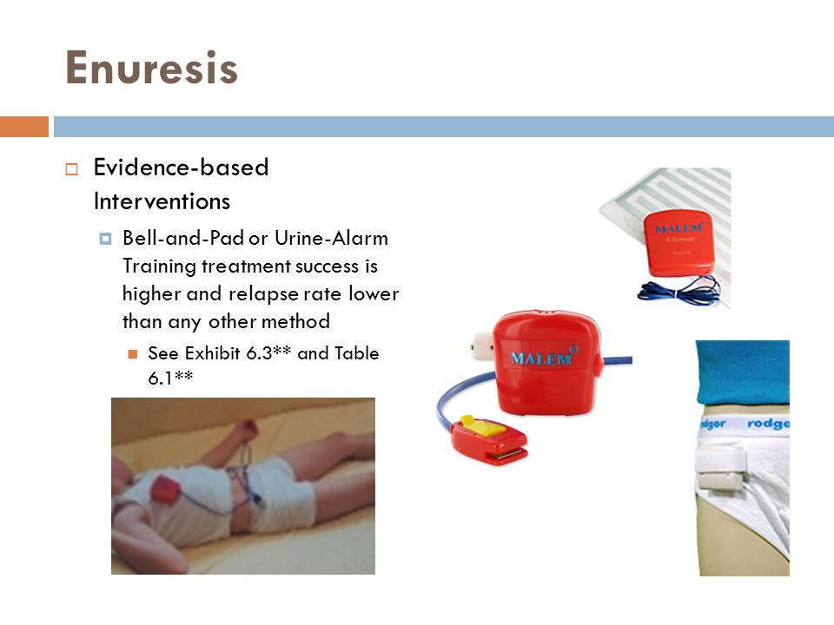

Slide 79
School Phobia

Slide 80
Introduction
The term school phobia was first used in 1941 to identify children who fail to attend school because attendance causes emotional distress and anxiety .
In Great Britain and as of the early 2000s in the United States, the term school refusal is preferred.
School phobia is a complex syndrome that can be influenced by the child's temperament , the situation at school, and the family situation.
Current thinking defines school phobia or school refusal as an anxiety disorder related to separation anxiety .

Slide 81
Children refuse to attend school because doing so causes uncomfortable feelings, stress, anxiety, or panic..
School refusal usually develops after a child has been home from school for an illness or vacation. It may also follow a stressful family event, such as divorce , parental illness or injury, death of a relative, or a move to a new school.

Slide 82
Causes
Children whose parents have anxiety disorders have a higher rate of anxiety disorders than children whose parents do not have these disorders.
School phobia is often associated with other anxiety disorders such as agoraphobia or other mental health disorders such as depression.
Some experts theorize that another possible cause of school refusal is traumatic and prolonged separation from the primary caregiver in early childhood.
Family functioning affects school refusal. Stressful events or a dysfunctional family can cause children to feel compelled to stay home.

Slide 83
Symptoms
Physical symptoms include dizziness, headaches, nausea , vomiting , diarrhea, shaking or trembling, fast heart rate, chest pains, and back, joint or stomach pains. These symptoms usually improve once the child is allowed to stay home.
Behavioral symptoms include temper tantrums, crying, angry outbursts, and threats to hurt themselves ( self-mutilation ).

Slide 84
Managing school refusal
Every child is unique. So each situation will be handled on an individual basis. These are some of the interventions that may be used to help the child:
Return the child to school. Make sure the school officials understand the situation and don't send the child home for the wrong reasons.
Think about family counseling if other problems exist.
Let the child talk about his or her concerns and fears.
Slowly separating the parent from the child in school may also be used. One approach is to have the parent sit with the child in the classroom at first. Then the parent may attend school, but sit in another room. Next, the parent may continue to get farther away.
A referral to a child psychologist or psychiatrist may be needed.

Slide 85
Treatment
1. Cognitive Behavior Therapy: A derivative of Behavior Therapy, this is done to correct inappropriate and maladaptive behaviour in the children.
2. Systematic Desensitisation: The child is gradually taught and helped to modify his reaction to school and make it less harsh on himself emotionally.
3. Exposure Therapy: The child is exposed to the stressful environment gradually, and is guided throughout to correct his maladaptive reactions to the situation and cope well with the changes.
4.Operant Behavioral Techniques: This involves rewarding the child for the desired behaviour so that the frequency of the behaviour increases.
5. Drugs: Serotonin reuptake inhibitors like Prozac are useful when trying to cure depression in the child.

Slide 86
LEARNING DISABILITIES

Slide 87
Introduction
Learning disabilities, or learning disorders, are an umbrella term for a wide variety of learning problems.
A neurodevelopmental problem in which a child of normal intellectual potential (that is, a child does not have an Intellectual Disability) is encountering unusual difficulty with their academic functioning that cannot be explained by inadequate educational opportunity or emotional or sensory disabilities.

Slide 88
A learning disability is defined as a “significant reduced ability to understand new or complex information, to learn new skills (impaired intelligence), with a reduced ability to cope independently (impaired social functioning), which started before adulthood”.
'Global Developmental Delay' (GDD) describes it as a condition that occurs between birth and the age of 18 which prevents a child from reaching key milestones of development like learning to communicate, processing information, remembering things and organising their thoughts.

Slide 89
Types
Learning disabilities in reading (dyslexia)
Signs of reading difficulty include problems with:
  letter and word recognition
  understanding words and ideas
  reading speed and fluency
  general vocabulary skills
Learning disabilities in math (dyscalculia)
A child with a math-based learning disorder may struggle with memorization and organization of numbers, operation signs, and number “facts” (like 5+5=10 or 5×5=25). Children with math learning disorders might also have trouble with counting principles (such as counting by twos or counting by fives) or have difficulty telling time.

Slide 90
Learning disabilities in writing (dysgraphia)
Learning disabilities in writing can involve the physical act of writing or the mental activity of comprehending and synthesizing information.
Basic writing disorder refers to physical difficulty forming words and letters. Expressive writing disability indicates a struggle to organize thoughts on paper.
Symptoms of a written language learning disability revolve around the act of writing. They include problems with:
  neatness and consistency of writing
  accurately copying letters and words
  spelling consistency
  writing organization and coherence

Slide 91
Learning disabilities in motor skills (dyspraxia)
Motor difficulty refers to problems with movement and coordination whether it is with fine motor skills (cutting, writing) or gross motor skills (running, jumping).
Signs that a child might have a motor coordination disability include problems with physical abilities that require hand-eye coordination, like holding a pencil or buttoning a shirt.

Slide 92
Learning disabilities in language (aphasia/dysphasia)
Language and communication learning disabilities involve the ability to understand or produce spoken language.
Signs of a language-based learning disorder involve problems with verbal language skills, such as the ability to retell a story and the fluency of speech, as well as the ability to understand the meaning of words, parts of speech, directions, etc.

Slide 93
Causes
Specific cause is not known. Possible causes include the following:
An inherited condition, meaning that certain genes passed from the parents affected the brain development, for example Fragile X.
Chromosome abnormalities such as Down’s syndrome or Turner syndrome.
Complications during birth resulting in a lack of oxygen to the brain.
A very premature birth.
Mother’s illness during pregnancy.
The mother drinking during pregnancy, for example Foetal Alcohol Syndrome.
A debilitating illness or injury in early childhood affecting brain development, for example a road traffic accident or child abuse.
Contact with damaging material (like radiation).
Neglect, and/or a lack of mental stimulation early in life.
Some people with learning disabilities have additional physical disabilities and/or sensory impairments.

Slide 94
Treatment
While there is no cure for specific learning disorder, there are many ways to improve reading, writing, and math skills for a child.
Treatment usually includes both strengthening the skills and developing a learning strategy tailored to take advantage of a child’s strengths. For example, repetition and mnemonic devices might make it easier to memorize a math formula, and drawing a picture to illustrate a word problem might help a child visualize what is being asked.

Slide 95
Treatment for specific learning disorder often also involves multimodal teaching. If a child has trouble comprehending a subject with his or her eyes and ears alone, other senses such as touch, taste, and even smell can play a role in the learning process. Similarly, learning to convert one sort of problem into another format may help (e.g. changing a traditional math problem into a word problem).
A learning specialist can help determine the services or accommodations a child might benefit from at school.
Psychotherapy, cognitive behavior therapy in particular, may also be helpful in treating the emotional and behavioral problems that can accompany specific learning disorder.

Slide 96
Below are just a few of the ways schools help children with specific learning disabilities
Dyslexia⁵
Intensive teaching techniques. These can include specific, step-by-step, and very methodical approaches to teaching reading with the goal of improving both spoken language and written language skills. These techniques are generally more intensive in terms of how often they occur and how long they last and often involve small group or one-on-one instruction.⁶
Classroom modifications. Teachers can give students with dyslexia extra time to finish tasks and provide taped tests that allow the child to hear the questions instead of reading them.
Use of technology. Children with dyslexia may benefit from listening to audio books or using word-processing programs.

Slide 97
Dysgraphia
Special tools. Teachers can offer oral exams, provide a note-taker, or allow the child to videotape reports instead of writing them. Computer software can facilitate children being able to produce written text.
Use of technology. A child with dysgraphia can be taught to use word-processing programs, including those incorporating speech-to-text translation, or an audio recorder instead of writing by hand.
Reducing the need for writing. Teachers can provide notes, outlines, and preprinted study sheets.
Dyscalculia⁷
Visual techniques. Teachers can draw pictures of word problems and show the student how to use colored pencils to differentiate parts of problems.
Memory aids. Rhymes and music can help a child remember math concepts.
Computers. A child with dyscalculia can use a computer for drills and practice.

Slide 98
Speech disorders (Stuttering)
Speech disorders are the problems in making sounds.
Children may have trouble making certain sounds such as “no” for “snow” or “wabbit” for rabbit; they may distort, add, or omit sounds.
Another aspect of speech that may be disturbed is fluency, which is manifested as a stutter comprised of hesitations and repetition. Fluency is the aspect of speech production that refers to continuity, smoothness, rate, and effort.

Slide 99
Stuttering, the most common fluency disorder, is an interruption in the flow of speaking characterized by repetitions (sounds, syllables, words, phrases), sound prolongations, blocks, interjections, and revisions, which may affect the rate and rhythm of speech.
Stuttering is a disorder of speech, characterised by the following features:
  1. Disturbed fluency and rhythm of speech.
  2. Intermittent blocking.
  3. Repetition of words rapidly.
  4. Prolongation of sounds.
  5. Associated anxiety or distress.
.

Slide 100
Stuttering typically has its origins in childhood. Most children who stutter, begin to do so around 2 ½ years of age (e.g., Mansson, 2007; Yairi & Ambrose, 2005; Yaruss, LaSalle, & Conture, 1998). Approximately 95% of children who stutter start to do so before the age of 5 years (Yairi & Ambrose, 2005).

Slide 101
Causes
Genetic Factors: Abnormal gene mutation
Neurophysiological Factors
  structural and functional neurological differences in children who stutter (Chang, 2014).
  deficiencies in left gray matter volume with reduced white matter integrity in the left hemisphere.
  reduced connectivity in areas that support the timing of movement control.
  more white matter connections in the right hemisphere as compared with normally fluent controls (Watkins, Smith, Davis, & Howell, 2008).

Slide 102
Environmental factors may exacerbate disfluency.
  These factors can include family dynamics, fast-paced lifestyle, stress and anxiety, and the child's temperament (Anderson, Pellowski, Conture, & Kelly, 2003).

Slide 103
Risk Factors For Persistent Stuttering
sex of child, as boys are at higher risk for persistence of stuttering than girls (Craig et al., 2002; Yairi & Ambrose, 2013);
family history of persistent stuttering (Kraft & Yairi, 2011);
time duration since onset of greater than 6 to 12 months or no improvement over several months (Yairi & Ambrose, 2005);
age of onset-children who start stuttering at age 3½ or later (Yairi & Ambrose, 2005);
co-occurring speech and language impairment (Ntourou, et al., 2011; Yaruss et al., 1998).

Slide 104
Signs and symptoms
Primary behaviors
  monosyllabic whole-word repetitions (e.g., "Why-why-why did he go there?"),
  part-word or sound/syllable repetitions,
  prolongations of sounds,
  audible or silent blocking (filled or unfilled pauses in speech),
  words produced with an excess of physical tension or struggle.

Slide 105
Secondary, avoidance, or accessory behaviors
  distracting sounds (e.g., throat clearing, insertion of unintended sound);
  facial grimaces (e.g., eye blinking, jaw tightening);
  head movements (e.g., head nodding);
  movements of the extremities (e.g., leg tapping, fist clenching);
  sound or word avoidances (e.g., word substitution, insertion of unnecessary words, circumlocution);
  reduced verbal output due to speaking avoidance;
  avoidance of social situations;
  fillers to mask moments of stuttering.

Slide 106
Treatment
The treatment is by behaviour modification techniques such as desensitization, biofeedback; and by techniques to diminish anxiety like relaxation therapy, drug therapy, or individual or group psychotherapy

Slide 107
Discussion
Roles of a nurse in child mental health problems

